Slide 1


Tompkins County SS4A Joint Safety Action Plan Public Meeting
December 9, 2024
Visit safestreetstompkins.com or scan here for more information:
Cambridge Systematics, Inc.
with Sam Schwartz Engineering
FHI Studio
Planning4Places

Slide 2
Agenda
Project Overview
Safety Data Analyses
Priority Locations
Plan Emphasis Areas & Systemic Analysis Highlights
Next Steps
Q & A

Slide 3
Project Overview

Slide 4
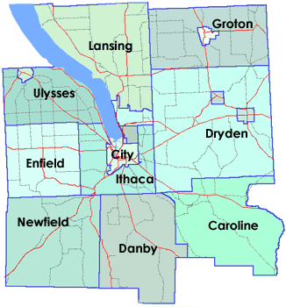
Tompkins County
Purpose of the Project
Develop a comprehensive Safe Streets for All (SS4A) Joint Safety Action Plan for Tompkins County
Provide recommendations for prioritized locations to help improve safety and strategies for eliminating fatalities and serious injuries throughout the region
Tompkins County and ten municipalities within Tompkins County have come together to prepare the Joint Safety Action Plan

Slide 5



Project Team
Project Team from Jurisdictions in Tompkins County
Tompkins County
City of Ithaca
Town of Ithaca
Village of Cayuga Heights
Town of Caroline
Town of Danby
Town of Dryden
Village of Dryden
Town of Lansing
Village of Lansing
Town of Newfield
Consultant Team

Slide 6
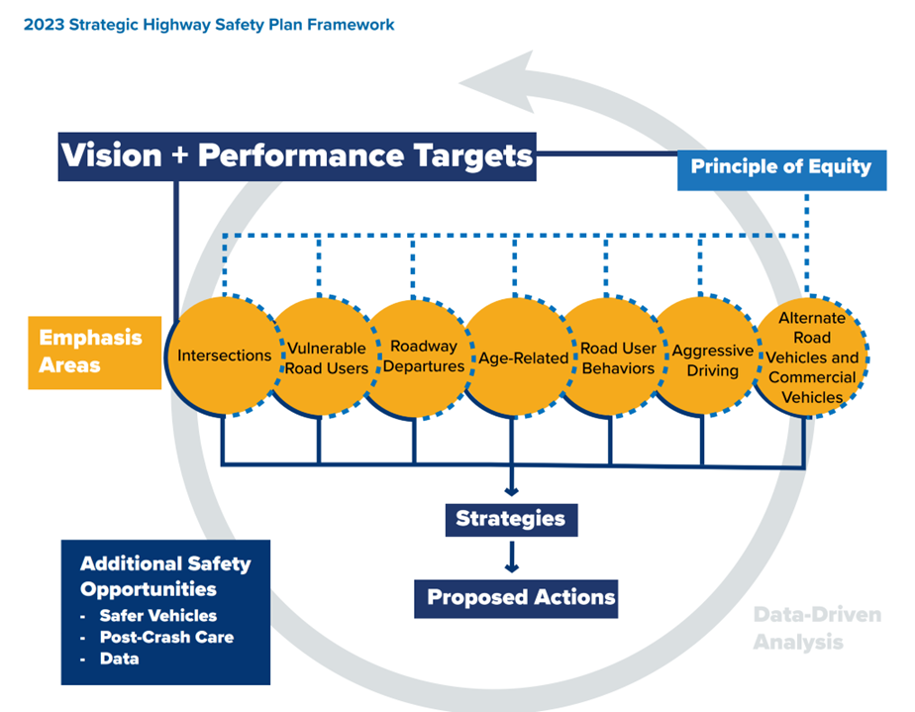
Joint Safety Action Plan Outcomes
Infrastructure, behavioral, and/or operational solutions
List of feasible, measurable, and scheduled action items aligned with 2023 New York SHSP
Performance measures to track efforts
Actions in alignment with Safe Systems Approach and National Roadway Safety Strategy
Lay the groundwork to successfully procure SS4A Implementation Grants

Slide 7
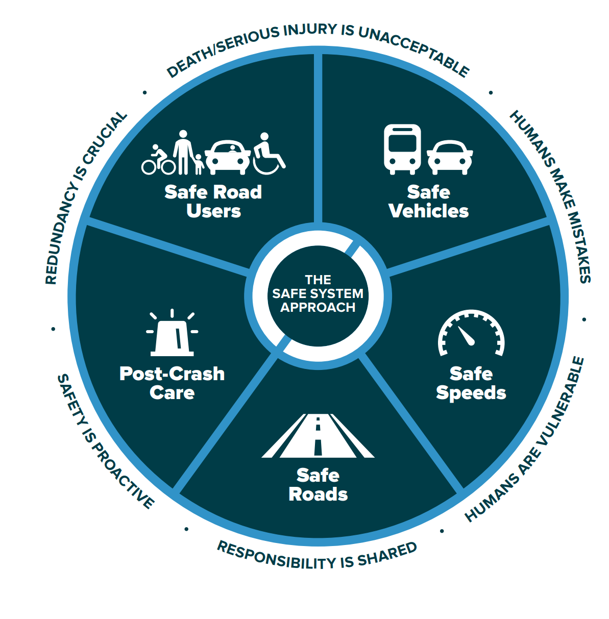
Safe System Approach
New York State adopted FHWA’s Safe System Approach for its transportation system.
NY SHSP’s Vision:
“New York State strives for an equitable and sustainable transportation system that works towards zero fatalities and zero serious injuries for all roadway users.”

Slide 8
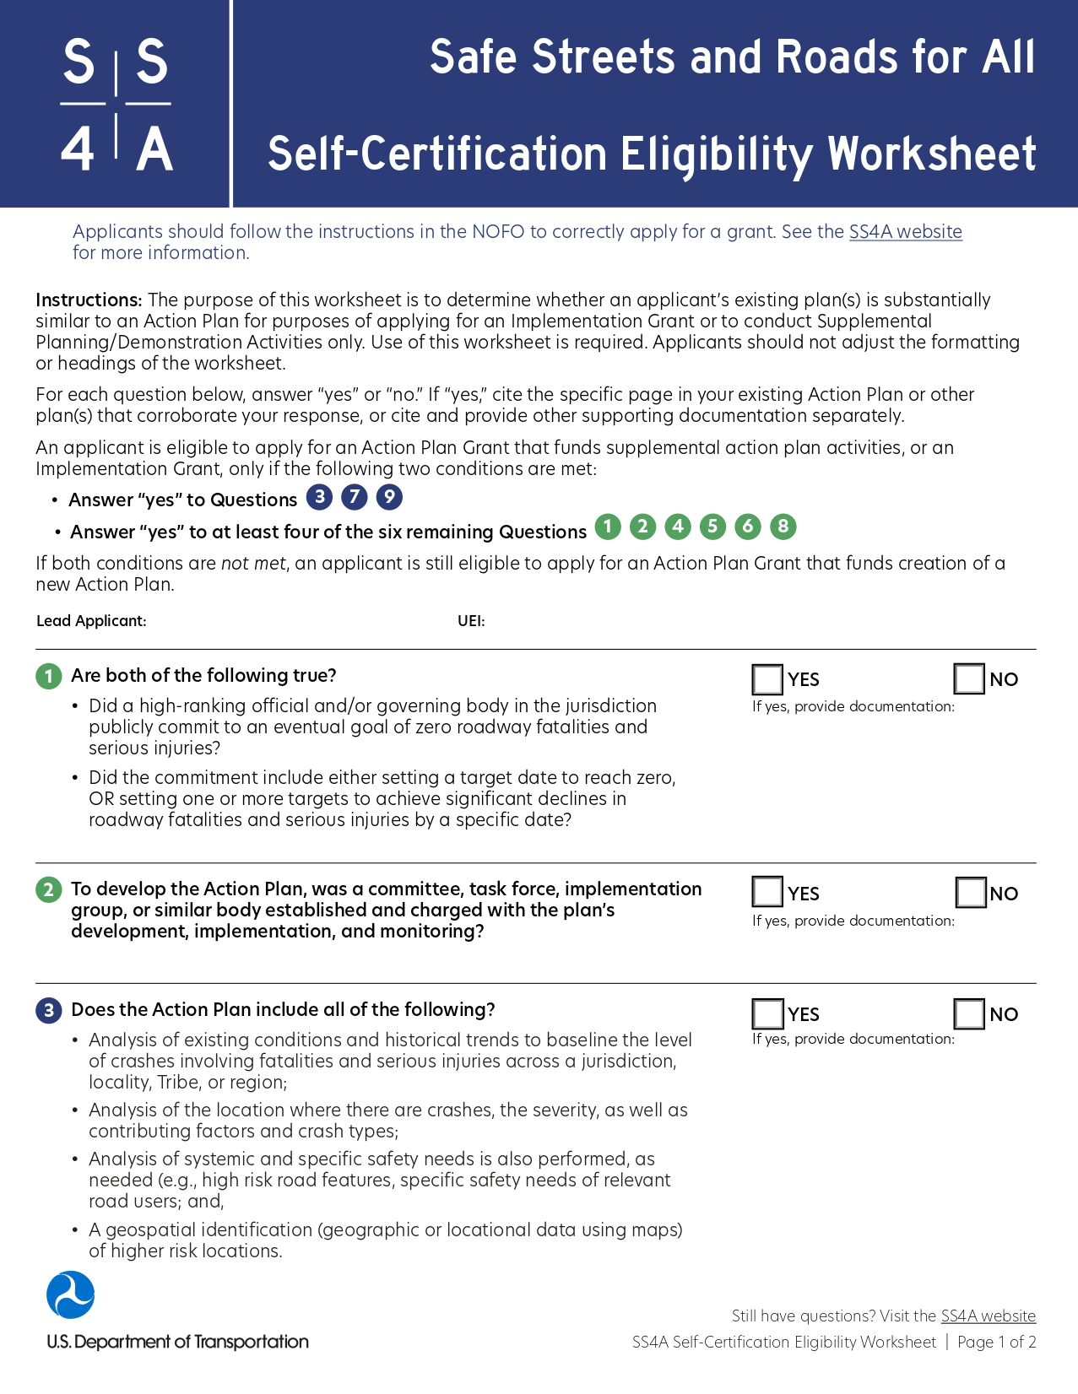
Joint Safety Action Plan Process
Identify key risk factors through a data-driven process
Engage with communities and local representatives
Determine policy and process changes
Prioritize strategies and projects to address safety concerns
Develop a plan compliant with SS4A requirements

Slide 9
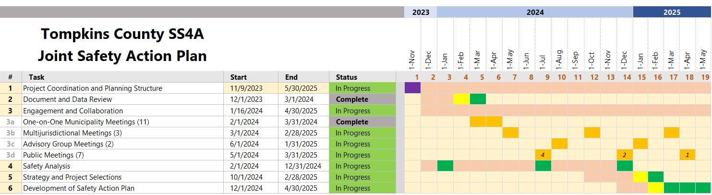
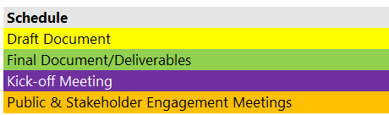
Project Schedule

Slide 10
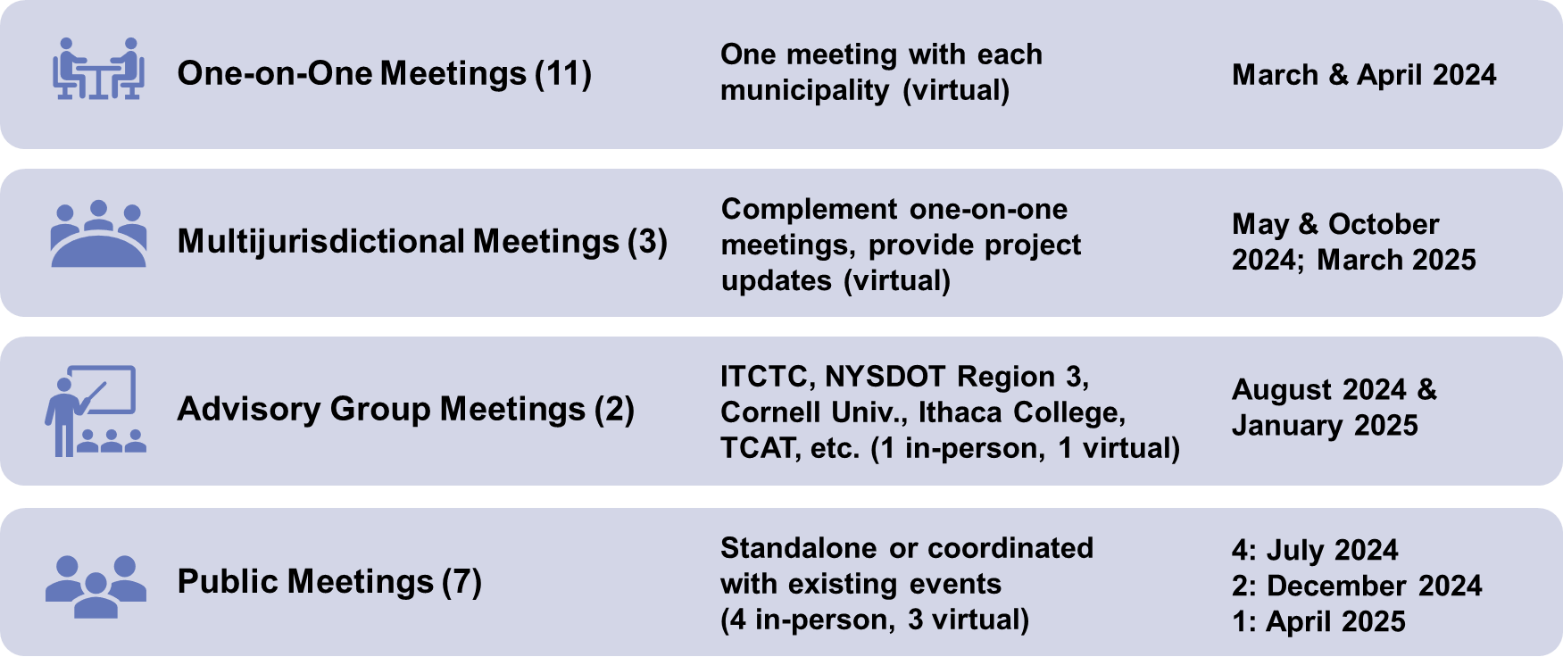
Public Engagement and Collaboration

Slide 11
Completed Tasks
Document Review Memo
Public Engagement Plan
Data Analysis Approach Memo
One-on-One Municipality Meetings and Summary Memo
Developed Website and Online Feedback Map
Historical Trends Memo
Crash Equity Memo
Public Engagement, Multi-Jurisdictional Meetings, and Advisory Committee Meeting
Network Screening & Systemic Approach Analysis

Slide 12
Safety Data Analyses

Slide 13
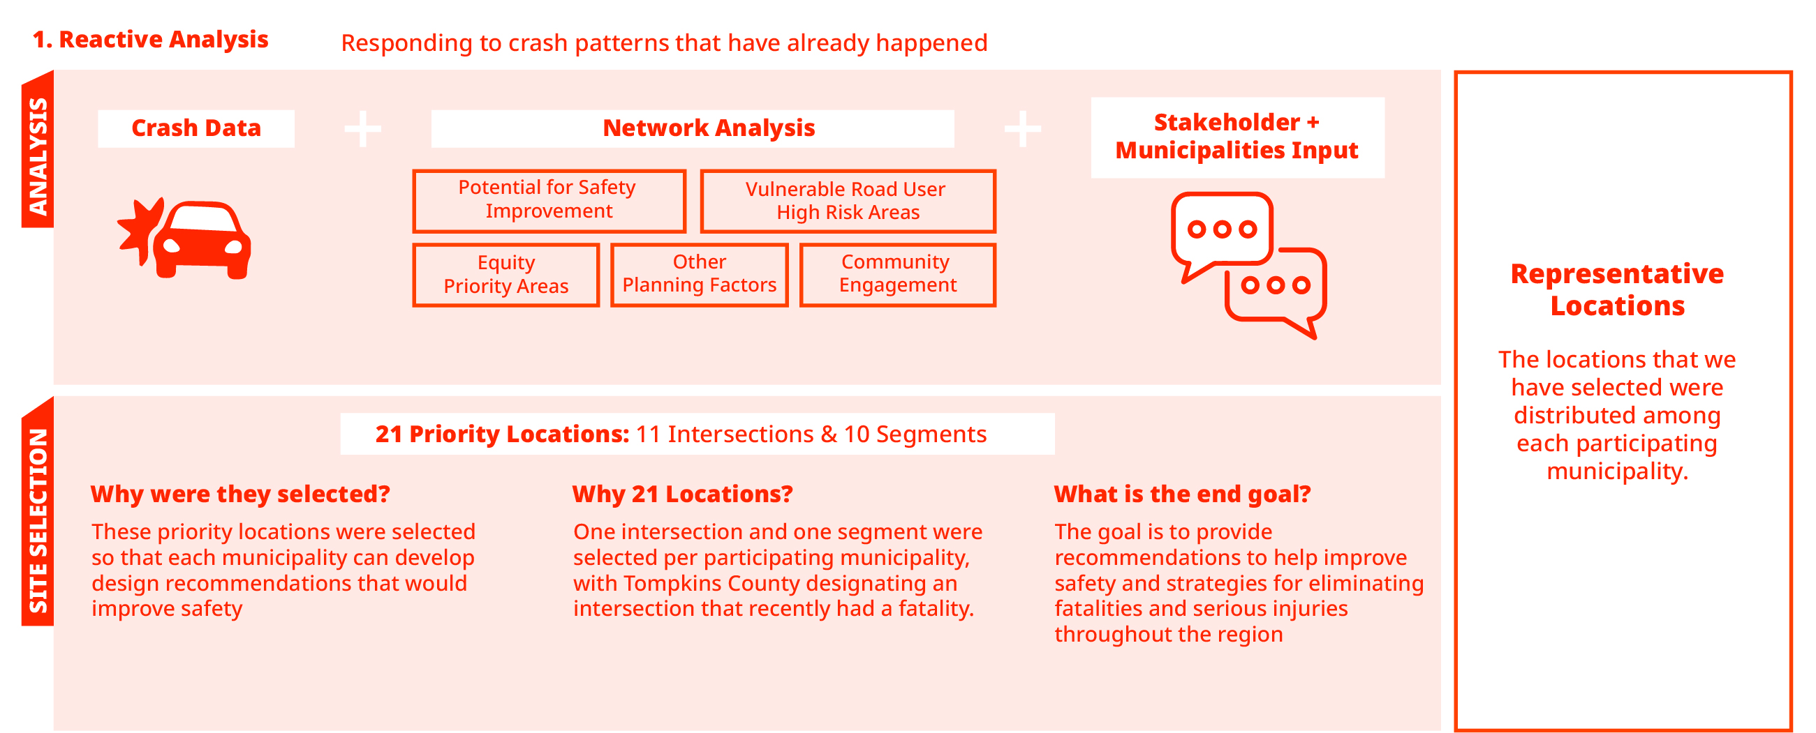
Responding to crash patterns that have already happened
Reactive Network Analysis
Potential for Safety Improvement
Vulnerable Road User High Risk Areas
Equity Priority Areas
Other Planning Factors
Community Engagement
Notes:
Next we started a network screening to identify high crash frequencies throughout the county’s network and overlayed locations with high potential for safety improvement (based on crash history) with other key criteria. These criteria were used to create a priority network of locations for the municipalities to consider going forward. Later in this presentation you will see representative locations (21) from this list pulled from each municipality in the county. The priority locations selected were meant to provide a diverse range of existing conditions and roadway types to be assessed and addressed with different sets of recommendations. These recommendations could then act as a blueprint for similar locations throughout the county on the larger priority network list.

Slide 14
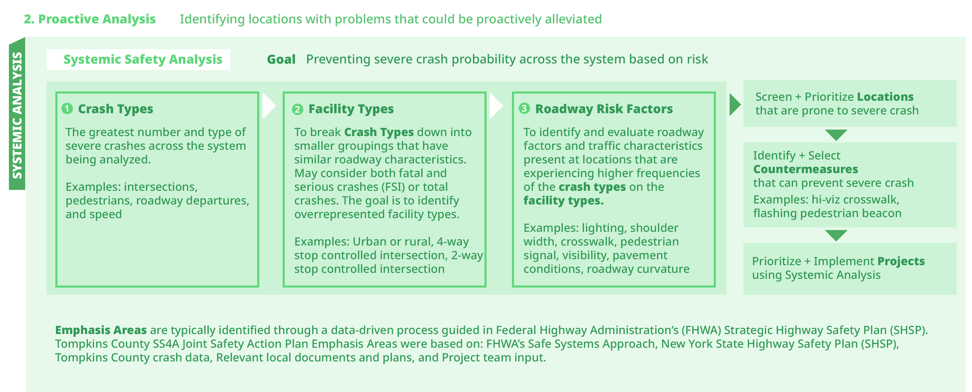
Proactive analysis aims to identify locations with problems that could be proactively alleviated
Proactive Network Analysis
Notes:
We also have a proactive approach…..

Slide 15
Draft Priority Locations

Slide 16
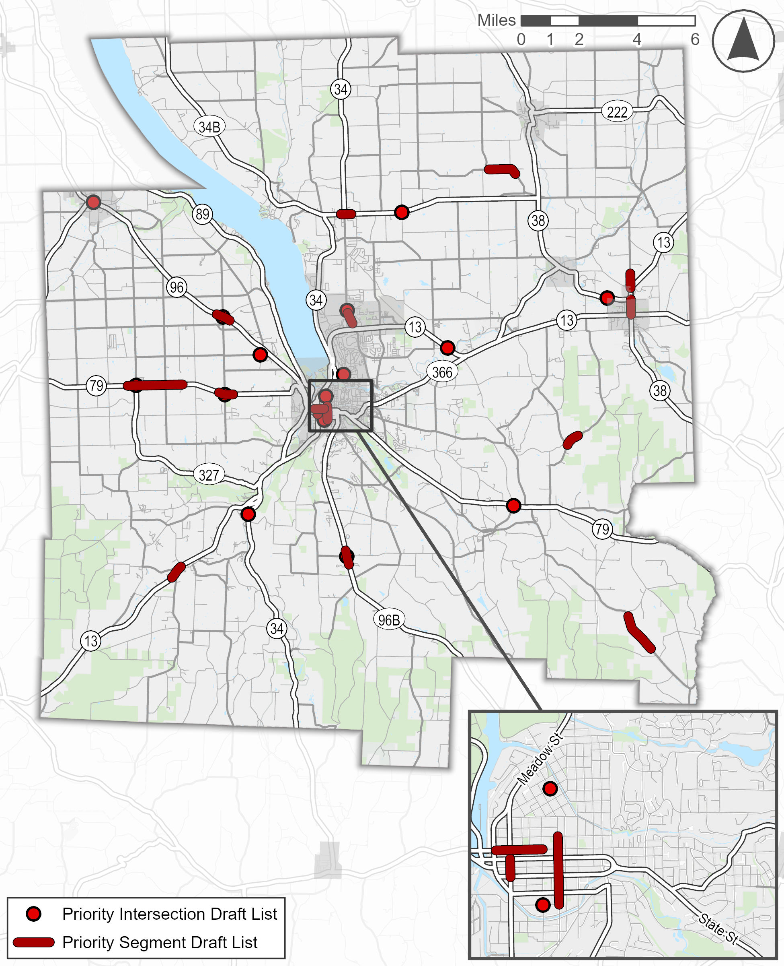
Draft Priority Locations (11) – Intersections
Location | Jurisdiction |  | Location | Jurisdiction
Hancock Street/1st Street | City of Ithaca |  | Peru South Lansing Rd & Scofield Rd | Town of Lansing
Valley Rd/Lounsberry Rd | Town of Caroline |  | West Danby Road/Decker Road | Town of Newfield
Station Rd/Maple Ave and Route 34/96 | Town of Danby |  | Cayuga Heights and Wyckoff St | Village of Cayuga Heights
Freeville Rd & Springhouse Rd (NY-38) | Town of Dryden |  | NY-13 & W Main St | Village of Dryden
Sheldon Road and West Dryden Road | Town of Dryden |  | North Triphammer Rd & Craft Rd | Village of Lansing
Hayts Road/Hopkins Road | Town of Ithaca
Highlighted locations in yellow have been previously identified by stakeholders
Highlighted locations in cyan have been previously identified by municipalities
*Italicized & bolded locations are on NYSDOT’s project lists (* indicates NYSDOT has offered to create a Regionally Initiated HSI (or Highway Safety Investigation)
Notes:
Based on the reactive data analysis that was just described, along with feedback from staff at each of the municipalities, we have selected locations that will receive safety improvement recommendations. We selected 11 intersections, and 10 segments, again based on crash data and risk factors, as well as input from staff at each of the participating municipalities. This list is representative of locations across the county. We initially included 10 intersection and 10 segments, but you will see that the Town of Dryden has two intersections, sadly because of a recent fatality at Sheldon Road and West Dryden Road, we added this location to this. You will also notice, some of the locations in addition to being verified by the crash data were also identified by stakeholders and municipality staff during the one-on-one meetings or multi-jurisdictional meetings- these are the locations highlighted in yellow or blue. The locations in bold/italic we also identified by NYSDOT - the New York State Dept of Transportation. This is not the final list of locations, as we are still finalizing the locations with municipalities.

Slide 17
Draft Priority Locations (10) – Segments
Location | Jurisdiction |  | Location | Jurisdiction
NY-13 NB between West Seneca St & West Green St | City of Ithaca |  | North Rd between Fall Creek Rd & NY-13 | Town of/ Village of Dryden
Seventy Six Rd | Town of Caroline |  | NY-34B NB between NY-34 & Van Ostrand Rd | Town of Lansing
NY-13 (Town of Newfield/Town of Ithaca Line to the City of Ithaca) | Town of Ithaca |  | NY-13 NB between Protts Hill Rd & Main St* | Town of Newfield
NY-79 NB between North Van Dorn Rd & Westhaven Rd | Town of Ithaca |  | NY-13 NB between NY-38 & W Main St | Village of Dryden
Route 96B from Miller Rd to Michigan Hollow Rd | Town of Danby |  | North Triphammer Rd | Village of Lansing
Highlighted locations in yellow have been previously identified by stakeholders
Highlighted locations in cyan have been previously identified by municipalities
*Italicized & bolded locations are on NYSDOT’s project lists (* indicates NYSDOT has offered to create a Regionally Initiated HSI (or Highway Safety Investigation)
Notes:
And here on this slide you will see the list of priority segments. The next step for the priority intersections and segments will be to develop infrastructure safety improvement recommendations at each location.

Slide 18

Field Observation Sites

Slide 19
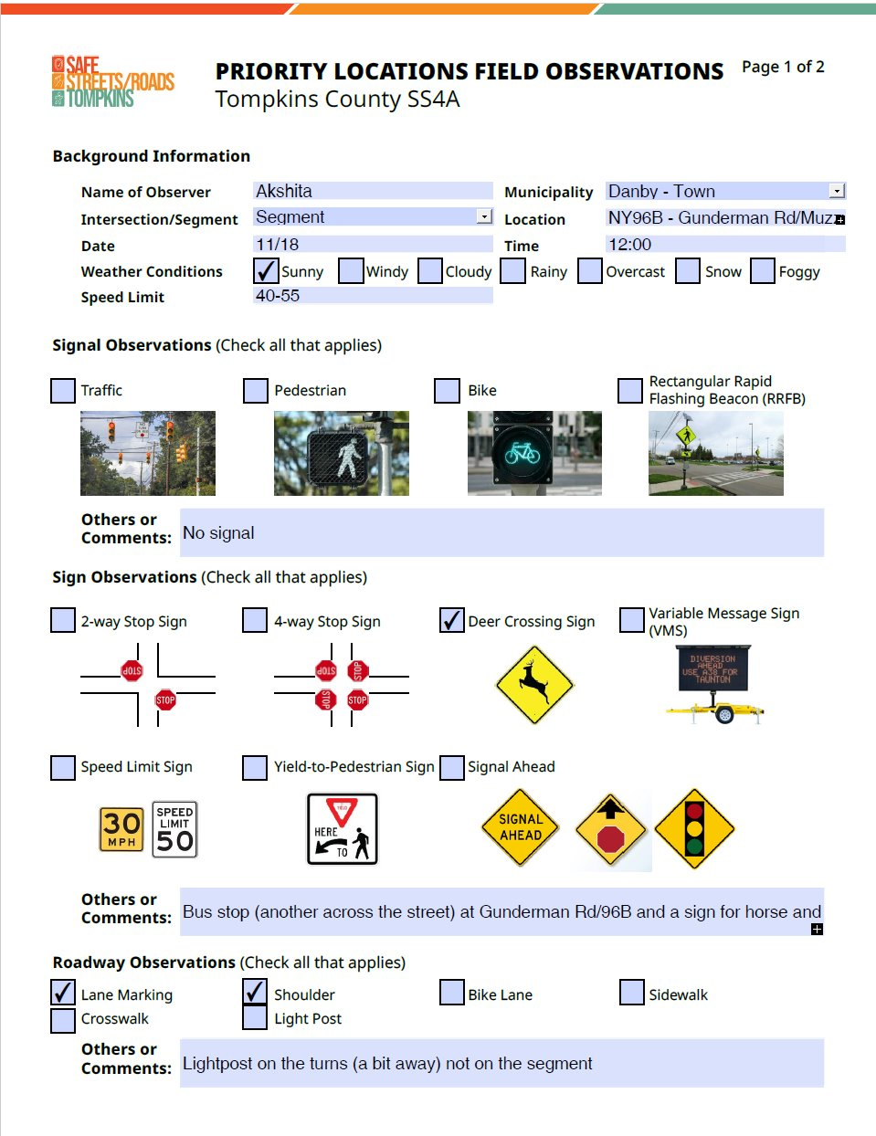
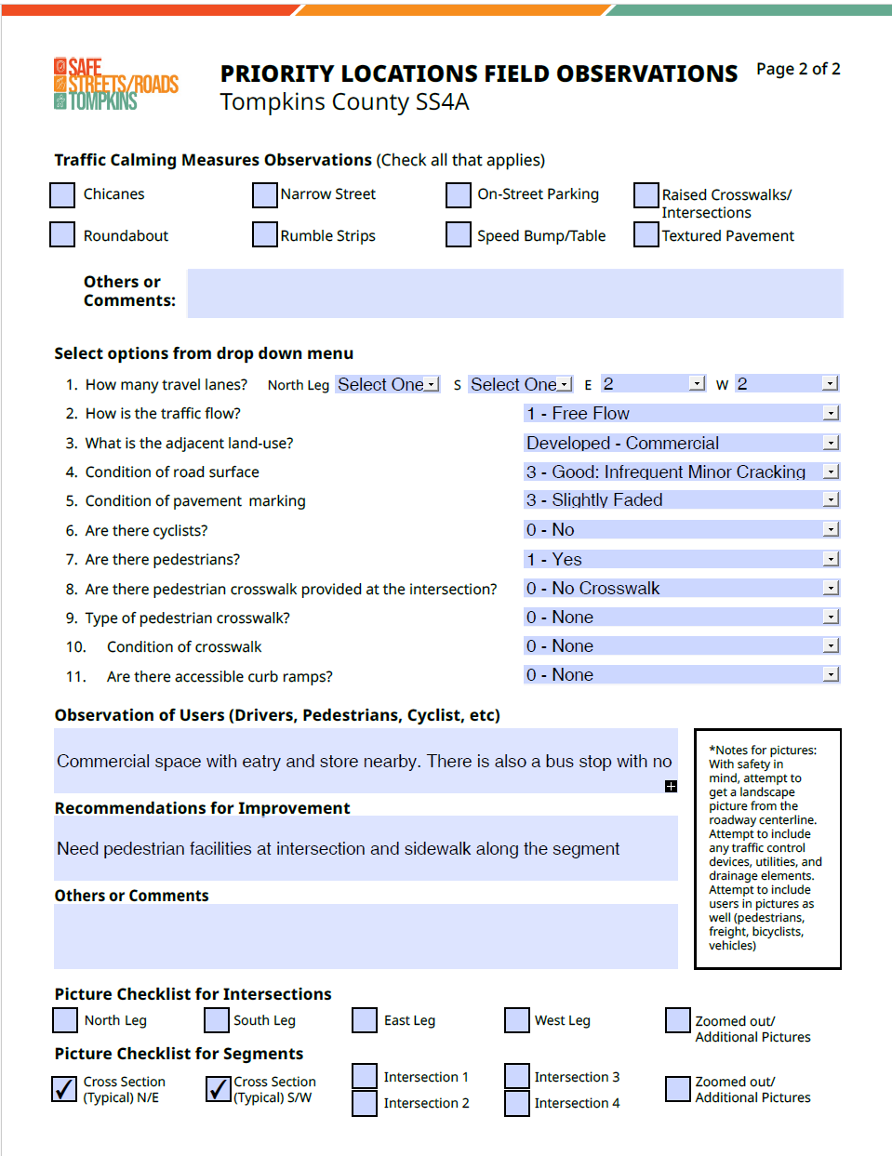
Field Observation Template

Slide 20
Plan Emphasis Areas & Systemic Analysis Highlights

Slide 21
How Were Emphasis Areas Determined?
Safe Systems Approach
New York State Highway Safety Plan
Tompkins County crash data
Review of relevant local documents and plans, including:
ITCTC’s Long-Range Transportation Plan
Tompkins County and municipal comprehensive plans
State Route 13 Corridor Study
Municipality input
Themes gathered from public input

Slide 22
Emphasis Areas & Systemic Analysis Highlights
Intersection crashes account for 10% of fatal and serious injury crashes over the last five years in Tompkins County. This increased from 4% of fatal and serious injury crashes in 2019 to 15% in 2023.
Intersections​
Vulnerable Road Users
​Roadway Departures
Age-Related
Older Drivers​
Younger Drivers
Distracted-and-Drowsy Driving​
Road User Behaviors
Alcohol-and-Drug-Impaired Driving​
Occupant Protection​
Speeding & Aggressive Driving
63% of pedestrian-related fatal and serious injury crashes occur at urban non-freeway arterial intersections, which only make up 17% of the intersections in the county.
Roadway departure crashes account for 18% of fatal and serious injury crashes in Tompkins County.
22% of speeding-related fatal and serious injury crashes occur on rural non-freeway arterials, which only make up 6% of the roadway mileage.

Slide 23
Secondary Emphasis Areas
Safer Vehicles
Alternate Road Vehicles
Commercial Motor Vehicles
Post-Crash Care
Data

Slide 24
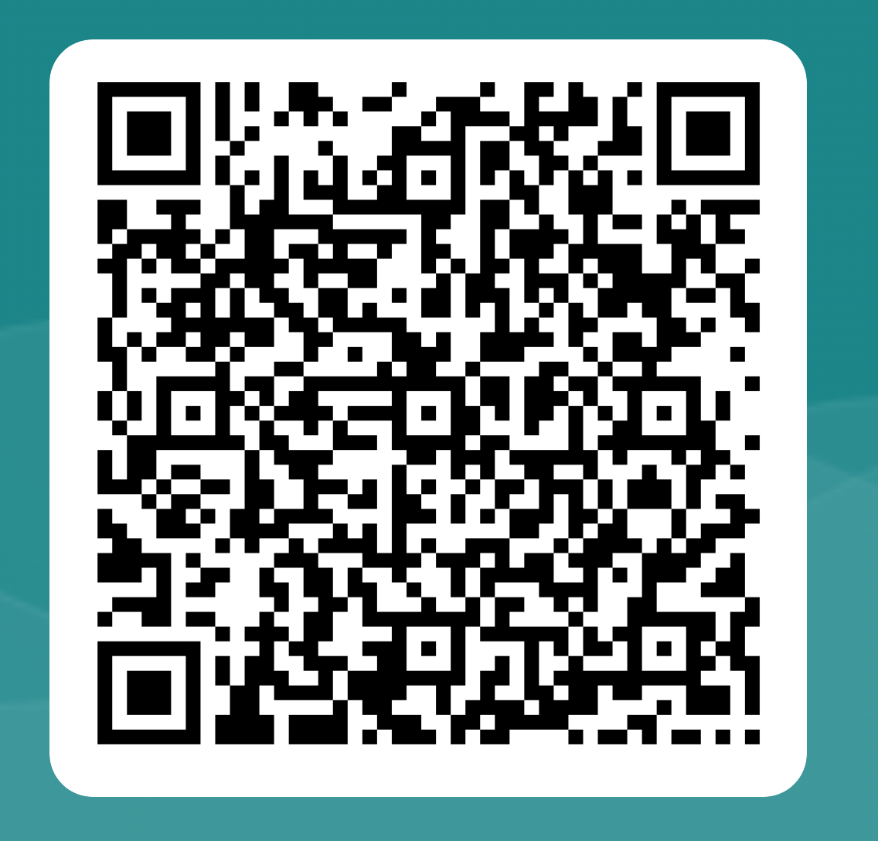
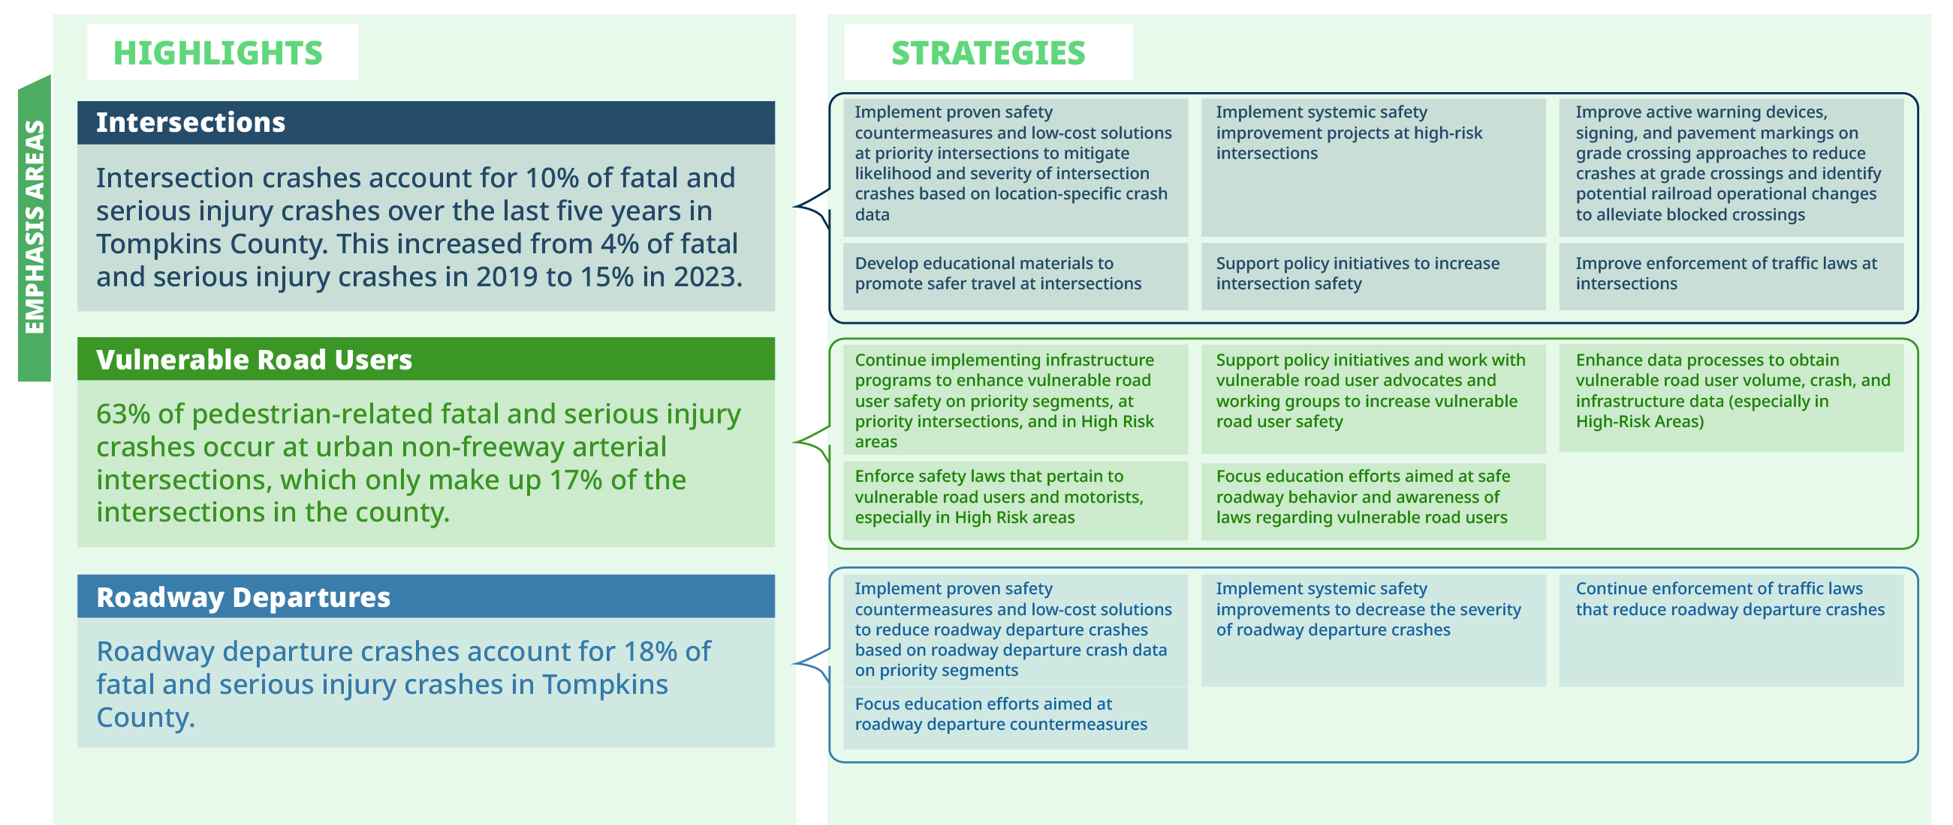
Give your
feedback
here!
Emphasis Areas
Notes:
We also have a proactive approach…..

Slide 25
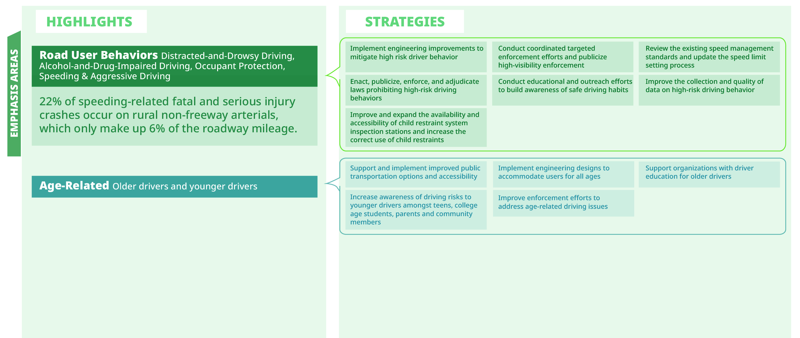
Give your
feedback
here!
Emphasis Areas
Notes:
We also have a proactive approach…..

Slide 26
Next Steps

Slide 27
Next Steps
Develop solutions/recommendations for priority locations
Complete the Network Analysis Memo
Complete public-facing crash data dashboards
Determine countermeasures for systemic locations
Draft the final Joint Safety Action Plan
Create templates for jurisdictions to adopt the Plan and Vision Zero

Slide 28
Q & A
Visit safestreetstompkins.com or scan here for more information:

